Slide 1
Proteins and the Microbiome: What to do with a list of hits
https://github.com/benghguthrie/MicrobiomeProteins
Benjamin Guthrie PhD
BMS 270
May 24, 2022
Notes:
Brief intro to me.
Get a brief intro from the students
What is your science background?
When/where did you first hear about the microbiome?

Slide 2
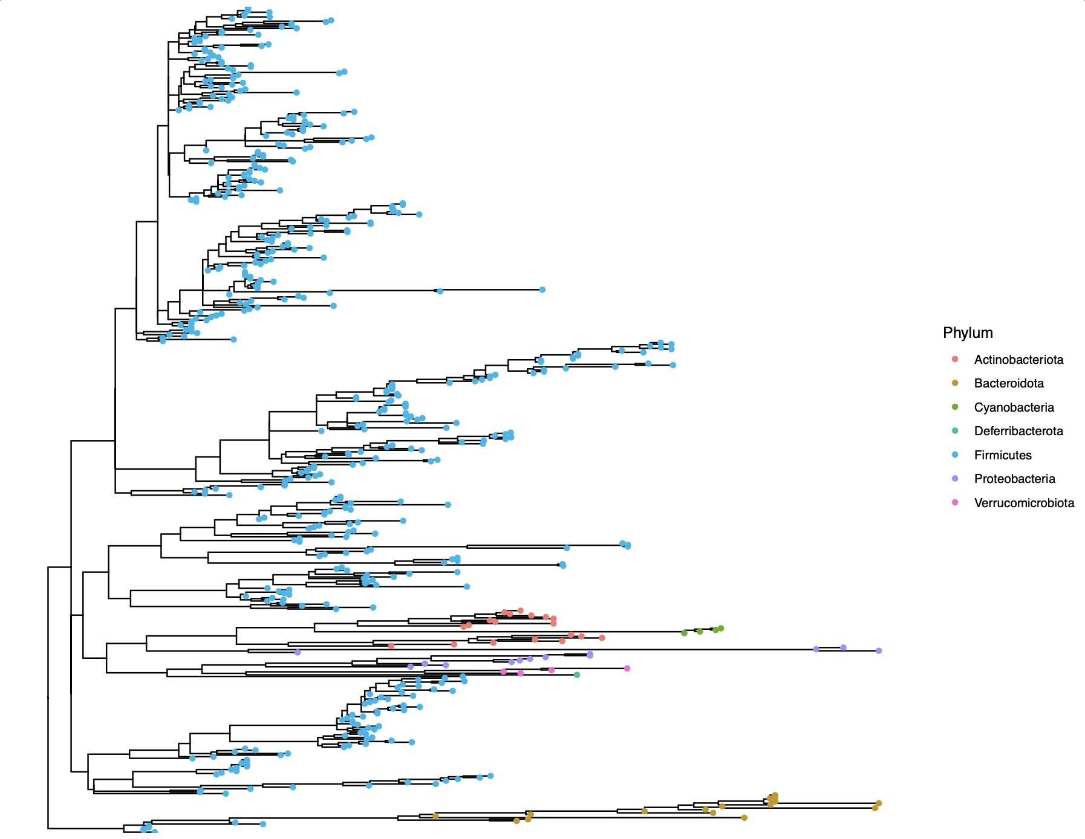
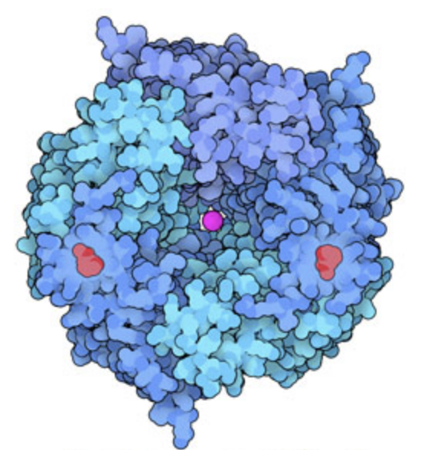
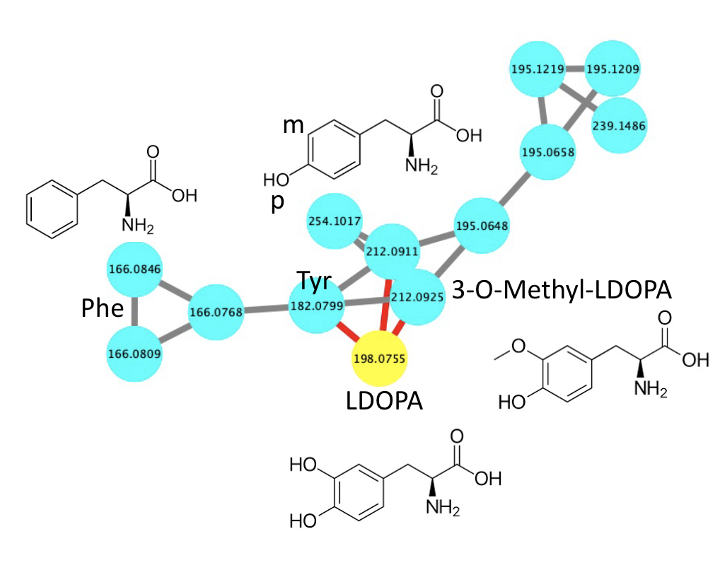
The past two workshops have led us to our session today
Protein Structure and Function
16S | Metagenomics
Metabolomics

Slide 3


The microbiome and protein function operate on different scales
Microbiome
Protein Function
(Drawing not to scale)
Notes:
Part of why I came to UCSF and to Peter’s lab is to figure out how to bridge these differences.

Slide 4
Let’s say you have a list of hits:
List of organisms
List of metabolites
What properties would you want to know about the proteins that relate to these hits?

Slide 5
Understanding protein function is critical
Brief list of how one might characterize protein function:
Multiple sequence alignments (is this residue conserved)
Percent identity (is this a homolog or something else)
Structure (what does this protein look like)
Enzyme kinetics (flux through the reaction)
Metabolite production (which enzyme(s) responsible)
Protein Protein Interactions (who is binding to whom)
Binding affinities (what concentrations are relevant)
Drug binding sites (type, concentration, strength of inhibitor)
… etc.
All are important to be able to “drug” the microbiome with a specific mechanism that could help patients without side effects.

Slide 6
Approach used depends on question posed
“Are there homologs of microbiome POI with different properties?”
Analyzing protein families of interest
“What is the biochemical function of this POI?”
Overexpression in cell or purified protein assays
“Does this POI (known drug target, activating enzyme, environmental enzyme) exist in the microbiome?”
Protein profile searching, from basic to advanced

Slide 7


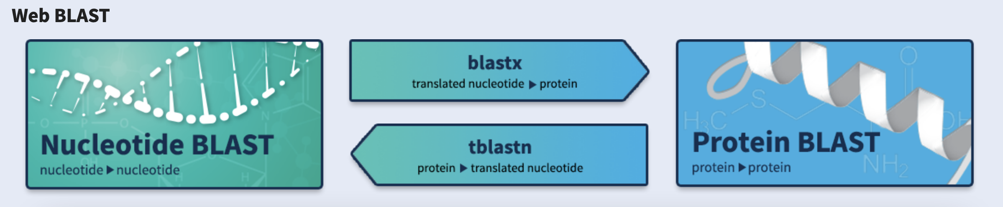
From genes… …or metabolites To proteins
https://www.kegg.jp/

Slide 8
Reminder of metabolic pathway of interest
TyrDC
Tyrosine
Tyramine
TyrDC
Levodopa
Dopamine

Slide 9

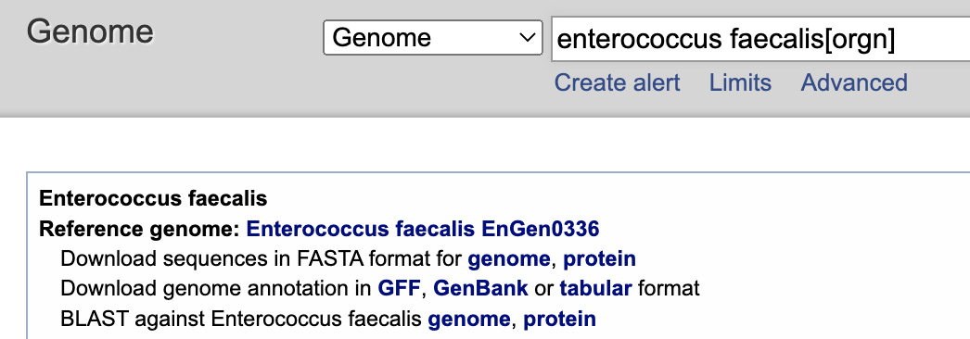
Working with Protein Sequence
Some options to obtain protein primary AA sequence
Uniprot (for specific, well characterized protein)
BlastP (for homologs, or to limit to one organism)
blastX (from a gene in a different organism)
NCBI: Genome (bacterial proteomes)
>sp|Q838D6|TYRDC_ENTFA L-tyrosine decarboxylase OS=Enterococcus faecalis (strain ATCC 700802 / V583) OX=226185 GN=tdc PE=1 SV=2 MKNEKLAKGEMNLNALFIGDKAENGQLYKDLLIDLVDEHLGWRQNYMPQDMPVISSQERT SESYEKTVNHMKDVLNEISSRMRTHSVPWHTAGRYWGHMNSETLMPSLLAYNFAMLWNGN NVAYESSPATSQMEEEVGHEFAHLMSYKNGWGHIVADGSLANLEGLWYARNIKSLPFAMK EVKPELVAGKSDWELLNMPTKEIMDLLESAEDEIDEIKAHSARSGKHLQAIGKWLVPQTK HYSWLKAADIIGIGLDQVIPVPVDHNYRMDINELEKIVRGLAEEQIPVLGVVGVVGSTEE GAVDSIDKIIALRDELMKDGIYYYVHVDAAYGGYGRAIFLDEDNNFIPYEDLQDVHEEYG VFKEKKEHISREVYDAYKAIELAESVTIDPHKMGYIPYSAGGIVIQDIRMRDVISYFATY VFEKGADIPALLGAYILEGSKAGATAASVWAAHHVLPLNVAGYGKLIGASIEGSHHFYNF LNDLTFKVGDKEIEVHTLTHPDFNMVDYVFKEKGNDDLVAMNKLNHDVYDYASYVKGNIY NNEFITSHTDFAIPDYGNSPLKFVNSLGFSDEEWNRAGKVTVLRAAVMTPYMNDKEEFDV YAPKIQAALQEKLEQIYDVK

Slide 10
Networks of Protein Families

Slide 11
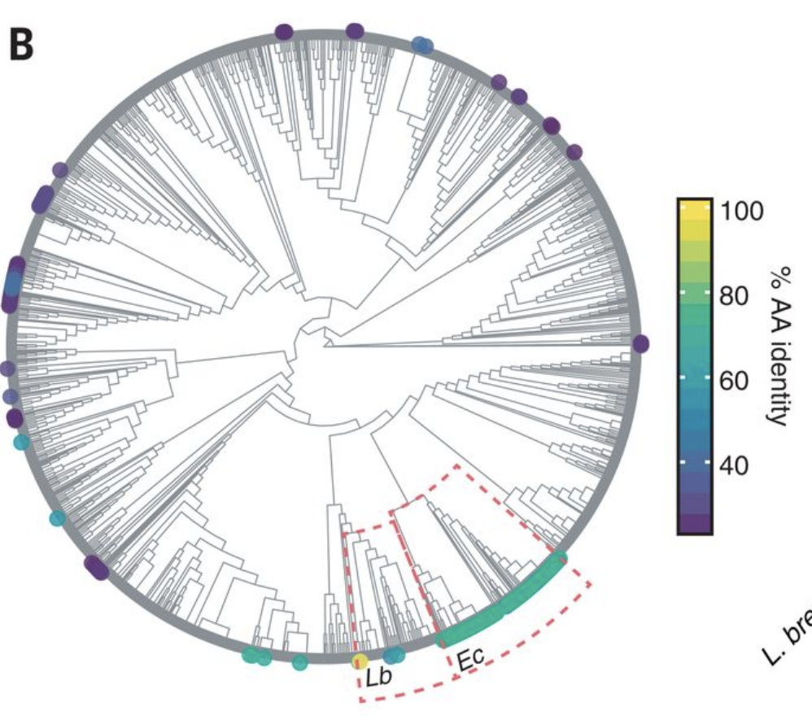
Networks to describe protein sequence similarity can help explore sequence space
However, without experience with several bioinformatic tools they take time to generate.
Example: Phylogenetic Trees with AA Identity mapped onto tips.
Rekdal, V., et al. Science, 364, 6445, (2019)

Slide 12
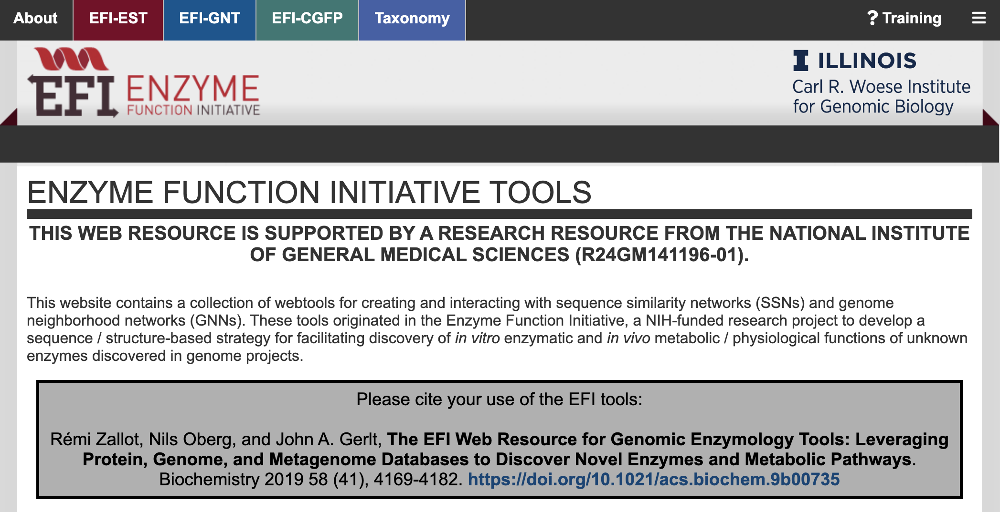
Introduction to the Enzyme Function Initiative
https://efi.igb.illinois.edu/

Slide 13
Networks to describe protein sequence similarity can help explore sequence space
However, without experience with several bioinformatic tools they take time to generate.
“Alignment Score”
Example: Phylogenetic Trees with AA Identity mapped on.
Eukaryota
Archaea
Bacteria

Slide 14
Introduction to the Enzyme Function Initiative
Let’s create an account and submit an InterPro family of choice for analysis (< 500 sequences).
https://efi.igb.illinois.edu/

Slide 15
Generating and Visualizing SSNs https://efi.igb.illinois.edu/ https://github.com/benghguthrie/MicrobiomeProteins

Slide 16
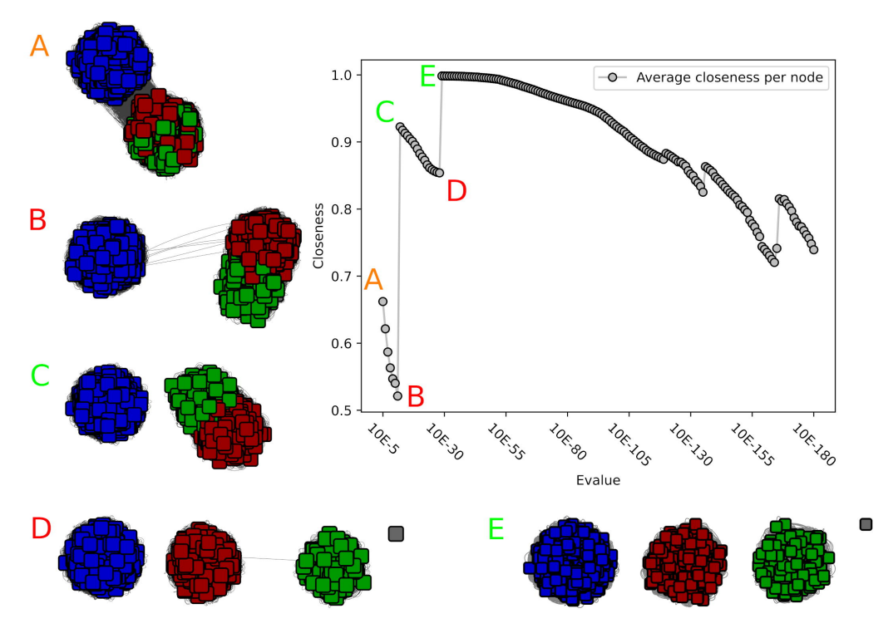
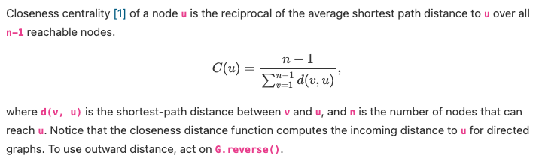
Choosing optimum Alignment Scores
Is there a way to know what alignment score to pick other than guessing and checking?
B. V. H. Hornung, N. Terrapon, An objective criterion to evaluate sequence-similarity networks helps in dividing the protein family sequence space. https://doi.org/10.1101/2022.04.19.488343
Notes:
CAZyme family GH55

Slide 18
Reminder of metabolic pathway of interest
TyrDC
Tyrosine
Tyramine
TyrDC
Levodopa
Dopamine

Slide 19
Working with Protein Structure
How to obtain protein structure
RCSB PDB: Crystallography and CryoEM .pdb filds for download
Prediction: AlphaFold and Robetta
Homology modeling: SWISS-MODEL and Phyre2
How to visualize
*UCSF Chimera
PyMOL
Side note: CASP15 is happening now!
Notes:
CASP: Critical Assessment of Structure Prediction

Slide 20
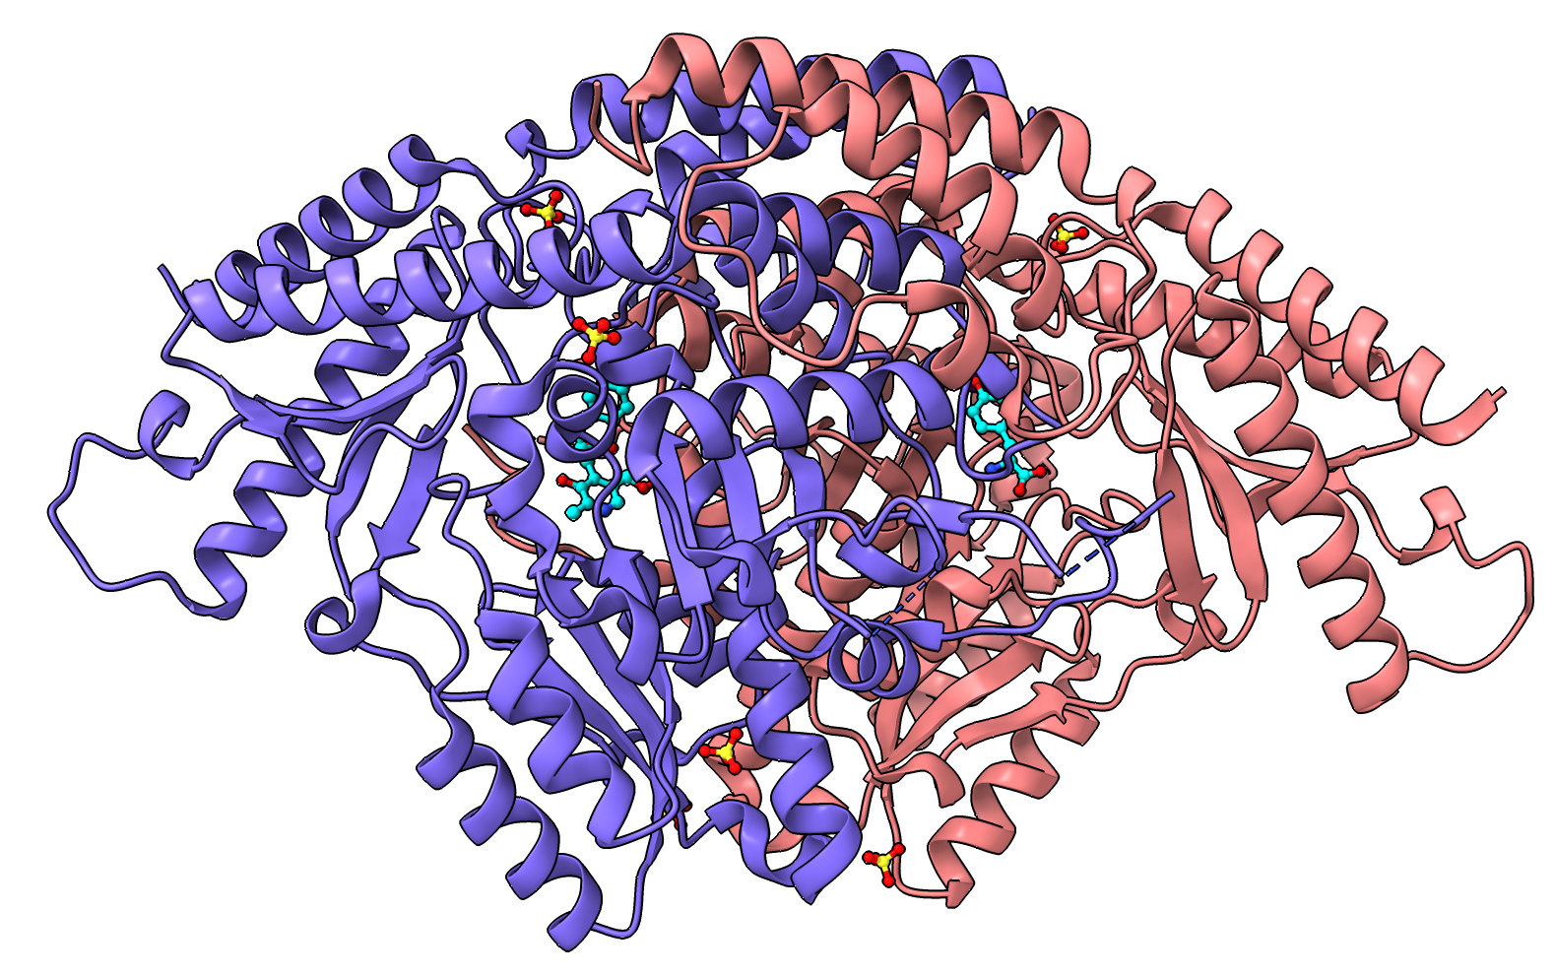
UCSF Chimera of TyrDC
“Open 6EEM”
Tutorial of ChimeraX in “Chimera” folder.
What are the two molecules in the active site?
If your PI would like you to add a tag (fluorescent, peptide, affinity tag), which termini would you add the tag to?
Default is N (anyone know why?)
But must check N term isn’t buried!
Notes:
Find N-terminus of PDB ID: 4U9B

Slide 21
Other websites/servers of interest
PharmGKB:
Provides information about how human genetic variation affects response to medications.
SPOKE:
The Neighborhood Explorer allows searching SPOKE for a node of interest, such as a specific drug compound, gene, or protein, and seeing what other nodes are in its immediate connectivity neighborhood, such as related diseases, side effects, pathways, and other compounds, genes, or proteins.
Others you know of?

Slide 22
Extra time? Go back and explore a tool/website of your choice!

